Slide 1
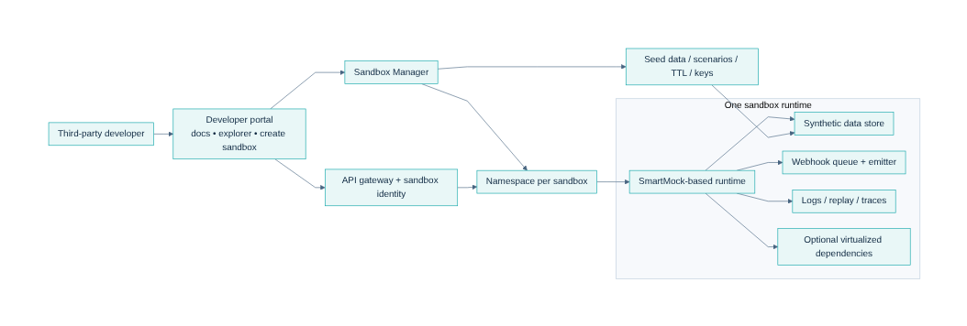
SmartSandbox
SmartSandbox Proposal
Evolve SmartMock into an isolated, portal-native partner sandbox platform with phased delivery and gated programmable behavior.
Audience: senior tech leaders
SmartMock today → SmartSandbox target → market view → roadmap
Mermaid architecture view embedded in deck
Draft proposal
Notes:
Talk track - This deck is an executive proposal rather than a deep implementation review. - The core recommendation is to keep SmartMock as the execution engine and build SmartSandbox around it as a platform layer. - The discussion covers current capability, target architecture, market comparison, and the roadmap needed for a safe rollout. [Sources] - Internal: Smart-Mock-Execution-Engine-Overview (1).md - Internal: ChatGPT-SmartSandbox summary.md - Internal: ChatGPT-Sandbox in developer portal (1).md

Slide 2
Executive recommendation
Senior tech leaders
Decision summary
Reuse SmartMock core
One runtime per sandbox
Namespace-per-sandbox default
Phased rollout
Keep the existing engine for dynamic endpoints, Groovy logic, validation, forwarding, templates, and OpenAPI-driven provisioning.
Provision a dedicated SmartMock-based runtime for each sandbox to meet the isolation requirement for external developers and custom behavior.
Use Kubernetes namespaces as the baseline isolation model now; keep stronger runtime classes or micro-VMs as an option for high-risk tenants.
Start with hardening plus MVP self-service sandboxing, then add differentiated fidelity features and only later broaden programmable authoring.
What this means commercially and technically
• Position SmartSandbox as production-like partner onboarding, not as another lightweight mock server.
• Differentiate on portal-native sandbox lifecycle, isolated runtimes, seeded data, signed webhooks, and replay.
• Treat programmable external authoring as an advanced mode that depends on security hardening and tenant policy.
• Use roadmap gates to protect cost, risk, and implementation focus.
Outcome
Retain existing SmartMock investment, reduce rewrite risk, and create a platform that can scale from API testing to higher-fidelity business-journey simulation.
SmartSandbox proposal
2/8
Notes:
Talk track - The recommendation keeps the engine you already have and moves the platform work outside the runtime rather than rewriting everything. - One runtime per sandbox matches the isolation requirement you stated for third parties and advanced custom behavior. - Namespace-per-sandbox is the practical operating default; stronger isolation remains available as a policy-driven exception. - The roadmap matters because security hardening is a prerequisite for external programmable authoring. [Sources] - Internal: Smart-Mock-Execution-Engine-Overview (1).md - Internal: ChatGPT-SmartSandbox summary.md - Internal: ChatGPT-Sandbox in developer portal (1).md

Slide 3
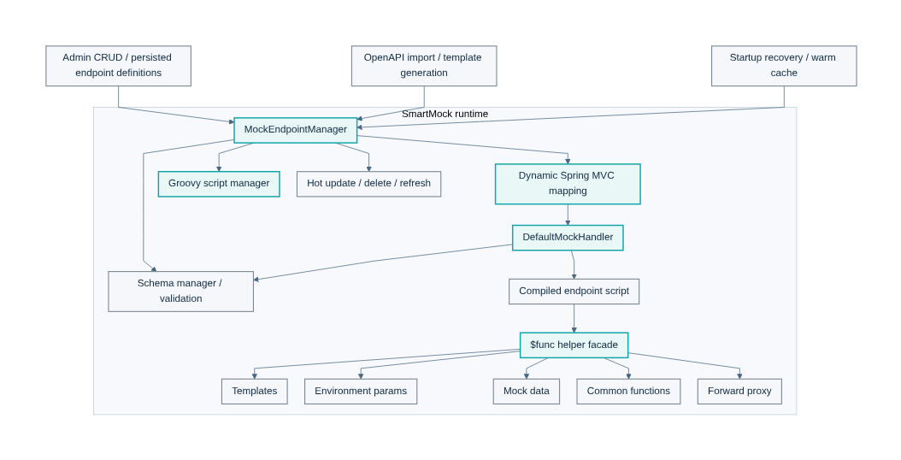
SmartMock today: strong execution engine, not yet a sandbox platform
Senior tech leaders
Current state
Strong today
Dynamic endpoint registration
OpenAPI import and template generation
Groovy compile, cache, and hot reload
Schema validation and forward proxy
Templates, env params, mock data, common functions
Still missing for SmartSandbox
Sandbox lifecycle APIs
Per-sandbox isolation and tenancy controls
Portal workflows, logs, replay, and webhook operations
TTL, quotas, seeded data, and hardened external authoring
Mermaid view of current SmartMock runtime capabilities
SmartSandbox proposal
3/8
Notes:
Talk track - The key point is that SmartMock already solves the hard runtime mechanics of API simulation. - Its strengths are dynamic registration, OpenAPI-driven provisioning, script execution, validation, forwarding, and hot updates without restart. - The missing pieces are platform concerns: sandbox lifecycle, isolation, developer experience, observability, and secure external programmability. - This is why SmartSandbox should wrap SmartMock rather than replace it. [Sources] - Internal: Smart-Mock-Execution-Engine-Overview (1).md

Slide 4
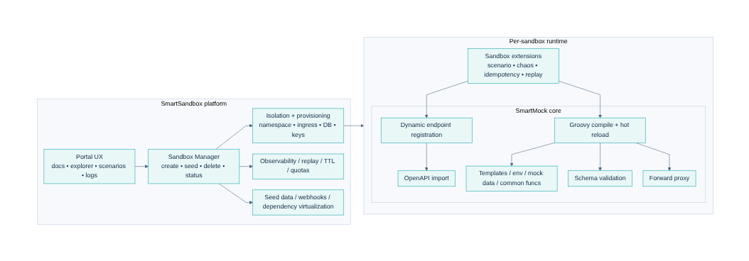
Target shift: SmartMock inside SmartSandbox
Senior tech leaders
Recommended platform boundary
Why keep SmartMock
Protect existing engineering investment, reuse proven runtime behavior, and accelerate delivery by building platform capability around a working engine.
What SmartSandbox adds
Lifecycle management, isolation, keys, ingress, seeded data, webhook operations, replay, observability, quotas, and policy-driven authoring controls.
SmartMock remains the runtime core; SmartSandbox adds the platform layers around it
Leadership implication
This is a platform build, not a runtime rewrite. Success depends on phase discipline and clear decisions on programmable tenant authoring.
SmartSandbox proposal
4/8
Notes:
Talk track - This is the architectural boundary the rest of the proposal depends on. - SmartMock is the execution kernel inside each sandbox, while SmartSandbox becomes the control plane and developer-facing product layer. - That keeps the architecture modular and gives you room to harden advanced authoring independently from the portal and provisioning layers. [Sources] - Internal: Smart-Mock-Execution-Engine-Overview (1).md - Internal: SmartSandbox_Architecture_Section_Consolidated.md

Slide 5
Target SmartSandbox operating model
Senior tech leaders
Future state
Target capability set
Self-service sandbox creation
Same API surface and auth semantics as production
Deterministic fixtures and scenario control
Signed webhooks with retry and replay
Imported third-party OpenAPI for broader business-case testing
Observable request timeline and logs
Target differentiation
Go beyond basic API mocks by combining isolated runtime provisioning, dependency simulation, and portal-native debugging workflows.
isolated
self-serve
observable
programmable
SmartSandbox proposal
5/8
Notes:
Talk track - The operating model is designed around one isolated runtime per sandbox, created and governed by the platform. - The developer experience becomes portal-native: create a sandbox, test APIs, trigger scenarios, receive webhooks, and debug with replay. - The differentiator is not just mock responses; it is isolated partner testing across realistic business flows. [Sources] - Internal: ChatGPT-SmartSandbox summary.md - Internal: ChatGPT-Sandbox in developer portal (1).md - Internal: SmartSandbox_Architecture_Section_Consolidated.md

Slide 6
Market position: where SmartSandbox can win
Senior tech leaders
Directional synthesis from official product docs reviewed today
Directional market view
Higher fidelity / control
SmartSandbox
ReadyAPI
WireMock
Microcks
MuleSoft
Apidog
Postman
Prism
Low
Ease / speed of adoption →
High
Placement is a reasoned synthesis from official docs, not a measured benchmark.
Pros of our proposal
Cons / watch-outs
Best fit for regulated partner onboarding
Stronger differentiation than a basic mock server
Reuse SmartMock and protect existing IP
Room to expand into business-journey simulation
Higher operating cost than shared SaaS mocks
Security hardening is mandatory before broad programmable use
Slower to launch than buying a lighter tool
SmartSandbox proposal
6/8
Notes:
Talk track - The market separates into lightweight mock tools and richer simulation or virtualization products. - SmartSandbox should not compete as another simple mock server; it should compete as an isolated partner-sandbox platform. - The benefit is stronger strategic differentiation, but the cost is a heavier operating model and a higher security bar for programmable behavior. - This slide is directional synthesis from official documentation rather than a laboratory benchmark. [Sources] - External: https://docs.wiremock.io/overview - External: https://docs.wiremock.io/openAPI/openapi - External: https://wiremock.org/docs/stateful-behaviour/ - External: https://microcks.io/ - External: https://learning.postman.com/docs/design-apis/mock-apis/tutorials/mock-with-examples - External: https://learning.postman.com/docs/design-apis/mock-apis/matching-algorithm - External: https://learning.postman.com/docs/design-apis/mock-apis/create-dynamic-responses - External: https://stoplight.io/open-source/prism - External: https://docs.apidog.com/mock-api-data-in-apidog-617869m0 - External: https://docs.apidog.com/mock-scripts-618209m0 - External: https://docs.mulesoft.com/api-experience-hub/simulating-api-calls-using-the-mocking-service - External: https://smartbear.com/product/ready-api/api-virtualization/

Slide 7
Roadmap with decision gates
Senior tech leaders
Recommended sequence
Phase 0
Phase 1
Phase 2
Phase 3
hardening foundation
MVP SmartSandbox
fidelity & differentiation
excellence tier
• Package runtime per sandbox
• Add tenant context and audit
• Constrain or gate raw Groovy authoring
• Create sandbox + seed data
• Namespace-per-sandbox
• Webhook retry / replay + portal logs
• Import 3rd-party OpenAPI
• Dependency virtualization
• Richer scenarios and CI drift controls
• Record-replay
• Time travel / schedulers
• Optional stronger isolation class
Gates between phases
Security controls proven → pilot demand validated → unit economics understood → premium features justified
SmartSandbox proposal
7/8
Notes:
Talk track - The roadmap is designed to de-risk external rollout by front-loading security and platform hardening. - Phase 1 is enough to launch a credible partner sandbox, while later phases add differentiation rather than basic viability. - Decision gates matter because programmable authoring and higher-fidelity simulation have real cost and security implications. [Sources] - Internal: SmartSandbox_Architecture_Section_Consolidated.md - Internal: ChatGPT-SmartSandbox summary.md

Slide 8
Leadership decisions needed now
Senior tech leaders
Approval points
Approve
Decide
Fund
SmartMock as the retained core execution engine inside SmartSandbox.
Default operating model: one runtime per sandbox, namespace-per-sandbox, schema-per-sandbox database to start.
Phase 0 and Phase 1 as the minimum safe path to a production-grade partner sandbox offering.
Success metrics to track from day one
TTFSC
Spin-up
Webhook
Adoption
time to first successful call
sandbox creation latency
delivery success + replay usage
active sandboxes and scenario coverage
Bottom line
Move forward with the platform build only if we explicitly accept the heavier operating model in exchange for stronger differentiation and partner onboarding value.
SmartSandbox proposal
8/8
Notes:
Talk track - The immediate ask is not every future feature; it is approval of the architecture direction and the first safe delivery scope. - Tracking the right metrics early is how we validate whether the heavier model is paying off for partner onboarding and developer experience. - If these approvals are made, the next working step is a detailed Phase 0 and Phase 1 implementation plan. [Sources] - Internal: SmartSandbox_Architecture_Section_Consolidated.md

Slide 9
Strategic Evolution: Developer Portal + SmartMock + SmartSandbox
• HSBC Developer Portal already covers API discovery and partner onboarding.
• SmartMock provides reusable Open Banking simulation runtime capability.
• SmartSandbox adds lifecycle management, isolation, scenarios, dynamic data and governance.

Slide 10
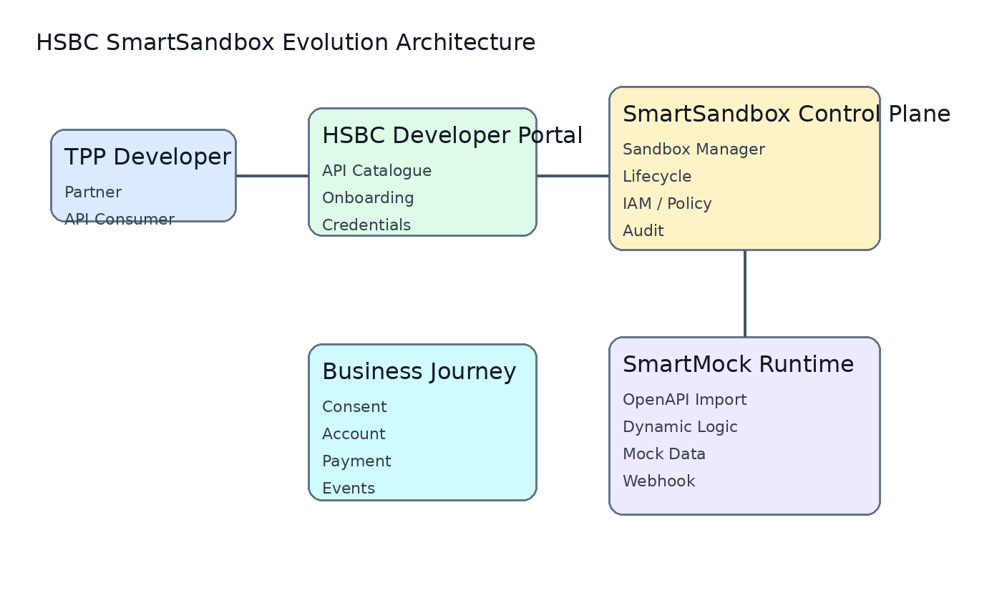
Target Architecture: SmartMock evolves into SmartSandbox
• Control Plane manages sandbox lifecycle.
• SmartMock remains the execution engine.
• Journey simulation enables consent, payment and event testing.

Slide 11
Major Comparison: DAC / DigitalAPI vs HSBC SmartSandbox
• DAC provides a mature Open Banking sandbox.
• HSBC advantage is existing portal ownership and SmartMock extensibility.
• Differentiation: end-to-end business journey simulation.
Capability | DAC | HSBC SmartSandbox
Portal | Vendor | HSBC owned
HKMA P3 | Supported | Proven
Consent | Standard | Custom journey
Dynamic Data | Configurable | State simulation
Custom Logic | Limited | SmartMock
Ownership | Vendor | HSBC

Slide 12
Long Term Roadmap: SmartMock -> SmartSandbox
• Phase 0: SmartMock hardening.
• Phase 1: Sandbox platform MVP.
• Phase 2: Advanced simulation.
• Phase 3: AI intelligent sandbox.

